Slide 1
HOLIER THAN THOU? SANCTIFYING ONESELF THROUGH ONE’S PROFESSION
Professional Ethics & Ethical Concerns
in Philippine Librarianship

Slide 2
How do people detect that you are a librarian?

Slide 3
6 Terms that Instantly Reveal You as a Librarian

Slide 4
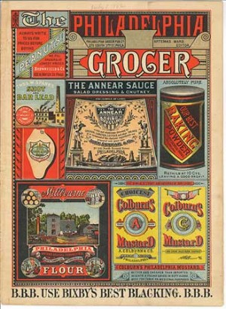
1) Ephemera
1: Items that are disposable or “short-lived” and usually collected by libraries for their graphic qualities or cultural significance such as menus, tickets, bookmarks, pamphlets, etc.
2: All that paper you’ve been meaning to clean out of your desk!

Slide 5
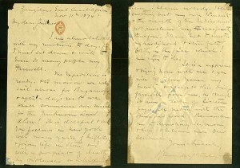
2) Primary Sources
1: No one knows for sure.
2: One of the most frustrating phrases ever heard by an undergraduate, this refers to a publication (or even an unpublished work such as a diary) which gives a first-hand account of an event or subject including newspaper clippings, interviews, transcripts, etc.

Slide 6
1: A book. Specifically one that is meant to be read sequentially, from cover to cover as opposed to a reference work such as a dictionary or encyclopedia.
2: Non-librarians may think you’re referring to getting your initials sewn on to an article of clothing at the mall.
3) Monograph

Slide 7
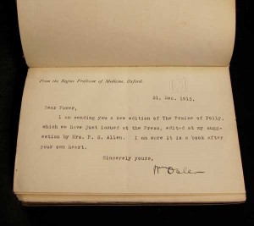
1: The history of ownership of a particular book, manuscript, or work of art.
2: Tracing and authenticating the provenance of a rare book is EXACTLY like the plot of The Ninth Gate, except without all the intrigue, danger, supernatural activities, high budget, and Johnny Depp.
4) Provenance

Slide 8
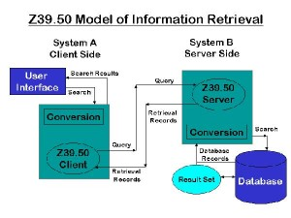
5) Z39.50
1: One of the battle droids in Star Wars that never made it out of the Battle of Utapau.
2: A protocol used to search remote databases, usually to retrieve cataloging records.

Slide 9
6) Shhhh!
1: A directive issued by librarians since ancient times that commands instant silence from all in attendance.
2: May be used in the library setting as well as in everyday interactions, assuming the person invoking the shh! is indeed a librarian.

Slide 10
SOME INSPIRING THOUGHTS

Slide 14
What a school thinks about its library is a measure of what it feels about education.
–Harold Howe

Slide 15
Without libraries what have we? We have no past and no future.
– Ray Bradbury

Slide 16
1) Call to Holiness 2) Way to Holiness: Moral Life 3) Sanctification of Work: Professional Ethics
What do we reflect about?

Slide 17
BASIC ARGUMENT:
1) We are all called by God to a life of holiness.
2) God provides us with the means to be holy. Our moral life is one.
3) Our profession can be our means to our personal sanctification.

Slide 18
(I) The call to holiness
Three basic assumptions:
Everything has a sufficient reason for being.
God created the human being in order to know and to love Him – to be in communion with God.
Man’s ULTIMATE END (purpose): participating in the life of God: A LIFE OF HOLINESS

Slide 19
(1) Sufficient reason
The Principle of Sufficient Reason is a powerful and controversial philosophical principle stipulating that everything must have a reason or cause.
Even what seems to be the most insignificant creature will prove to be existing for a certain reason or cause.
Hence, existence is never devoid of rationality, or else, it would be meaningless.
But meaninglessness does not seem to have the last word. We can always find meaning in everything.

Slide 20
(2) TO KNOW & TO LOVE GOD
“God created everything for man, but man in turn was created to serve and love God and to offer all creation back to him” (CCC, 358).
“Of all visible creatures only man is able to know and love his creator. He is the only creature on earth that God has willed for its own sake, and he alone is called to share, by knowledge and love, in God's own life” (CCC, 356).
“It was for this end that he was created, and this is the fundamental reason for his dignity.”

Slide 21
(3) Called to be holy
Man “is called by grace to a covenant with his Creator, to offer him a response of faith and love that no other creature can give in his stead (CCC, 357).
“Holiness is not the prerogative of only a few: holiness is a gift that is offered to all, without exception, so that it constitutes the distinctive character of every Christian.” (POPE FRANCIS)

Slide 22
(3) Called to be holy
“Everyone is called to holiness in their own state of life. Indeed, it is by living with love and offering Christian witness in our daily tasks that we are called to become saints…
“Always and everywhere you can become a saint, that is, by being receptive to the grace that is working in us and leads us to holiness.” (Pope Francis)

Slide 23
(3) Called to be holy
It is knowing what God has planned for us, then, obeying God’s will.
The Church in Lumen Gentium tells us that in order to know God’s will we are to hear the Word of God, use the sacraments, participate in liturgy, pray, give of ourselves in self-giving love and exercise the virtues.

Slide 24
(3) Called to be holy
All the faithful of Christ of whatever rank or status, are called to the fullness of the Christian life and to the perfection of charity; ...
They must follow in His footsteps and conform themselves to His image seeking the will of the Father in all things.
They must devote themselves with all their being to the glory of God and the service of their neighbor.
-- Lumen gentium, 40

Slide 25
(iI) The way to holiness
Three basic means:
Word of God
Sacraments & Prayer
Sacrifices & Virtues (Moral Life)

Slide 26
FUNDAMENTAL PRINCIPLES THAT GUIDE OUR MORAL LIFE
The point of principles:
Principles are certain.
Principles are universal.
Principles are objective.

Slide 27
Moral principles are necessary for salvation.
No moral principles = no sin = no repentance = NO SALVATION.
Having moral principles – believing them – is very important, but following them is even more important.
FUNDAMENTAL PRINCIPLES OF MORALITY

Slide 28
MORALITY IS THE QUALITY OF GOODNESS OR EVILNESS OF A HUMAN ACT.
WHAT MAKES ANY ACT GOOD OR EVIL?
FUNDAMENTAL PRINCIPLES OF MORALITY

Slide 29
Everything in this world has a purpose (end or aim). God created us for a certain purpose.
God created us TO KNOW & TO LOVE HIM. Our ULTIMATE END IS eternal happiness with God – HOLINESS!
Whatever leads us to our ULTIMATE END is GOOD. Whatever hinders us from our ULTIMATE END is EVIL (morality).
FUNDAMENTAL PRINCIPLES OF MORALITY

Slide 30
WHAT MAKES ANY ACT GOOD OR EVIL?
“The morality of human acts depends on:
the object chosen;
the end in view or the intention;
the circumstances of the action”
(CCC 1750).*
FUNDAMENTAL PRINCIPLES OF MORALITY

Slide 31
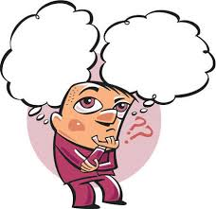
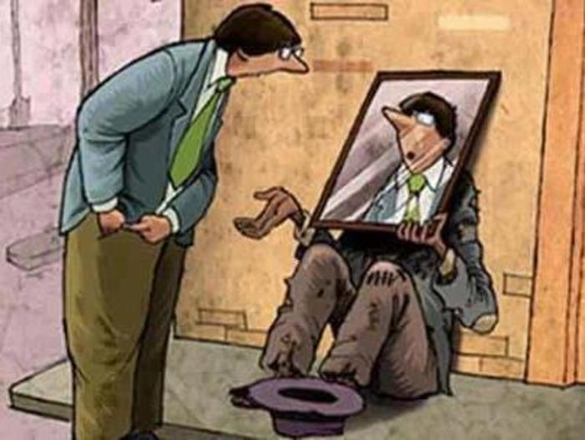
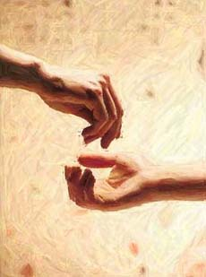
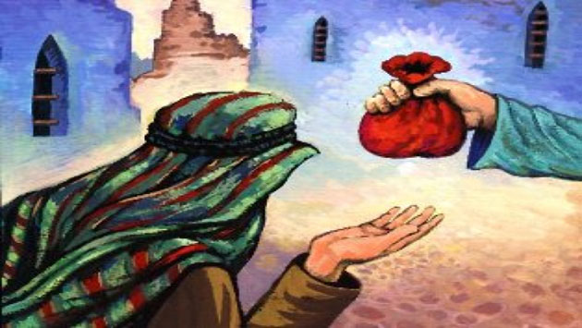
ULTIMATE END OF MAN
DO THESE CONFORM TO THE TRUE GOOD?
INTENTION
OBJECT
CIRCUMSTANCES
FUNDAMENTAL PRINCIPLES OF MORALITY

Slide 32
ULTIMATE END OF MAN
DOES IT CONFORM TO THE TRUE GOOD?
OBJECT
The “matter” of the HUMAN ACT that the will chooses to perform: a good toward which the will deliberately directs itself
Whether an act of will is GOOD or BAD depends upon the object
There are INTRINSICALLY EVIL ACTS: abortion, euthanasia, murder
FUNDAMENTAL PRINCIPLES OF MORALITY

Slide 33
ULTIMATE END OF MAN
DOES IT CONFORM TO THE TRUE GOOD?
INTENTION
Result desired by the agent in performing the act
Bad intentions can make good acts bad
Good intentions can NEVER make bad acts good.
FUNDAMENTAL PRINCIPLES OF MORALITY

Slide 34
ULTIMATE END OF MAN
DOES IT CONFORM TO THE TRUE GOOD?
CIRCUMSTANCES
Situations and consequences surrounding the performance of the act.
They do not CHANGE the nature of an act
They contribute to increasing / diminishing of the morality of acts & the responsibility or culpability of the agents.
FUNDAMENTAL PRINCIPLES OF MORALITY

Slide 35
RELATIONSHIPS AMONG THE THREE ELEMENTS
ANY ONE OF THE THREE ELEMENTS ALONE IS ENOUGH TO MAKE AN ACT EVIL, BUT ONE ALONE IS NOT ENOUGH TO MAKE IT GOOD
For a human act to be good, you must:
“DO THE RIGHT THING FOR THE RIGHT REASON IN THE RIGHT WAY”.
FUNDAMENTAL PRINCIPLES OF MORALITY

Slide 36
3 OVERSIMPLIFIED MORALITIES
LEGALISM stresses OBJECTIVE ACT ITSELF.
SUBJECTIVISM stresses the SUBJECTIVE INTENTION.
MORAL RELATIVISM (Situation Ethics) stresses changing situations or CIRCUMSTANCES.
FUNDAMENTAL PRINCIPLES OF MORALITY

Slide 37
THE THREE (3) RELATIONSHIPS
Every person in the world is related, in right or wrong ways: (1) to OTHERS; (2) to SELF; and (3) to GOD.
HOW ARE YOUR RELATIONSHIPS with others, yourself and God?
FUNDAMENTAL PRINCIPLES OF MORALITY

Slide 38
THE THREE (3) PARTS OF MORALITY
SOCIAL ETHICS: your relationship with others
INDIVIDUAL ETHICS: your relationship to yourself; virtues and vices, character
LIFE OF PIETY: your relationship with God
FUNDAMENTAL PRINCIPLES OF MORALITY

Slide 39
HIERARCHY OF DEPENDENCE OF THE THREE
“We are not at peace with others because we are not at peace with ourselves, and we are not at peace with ourselves because we are not at peace with God” (Thomas Merton)
FUNDAMENTAL PRINCIPLES OF MORALITY

Slide 40
LOVE: THE MOST BASIC MORAL VALUE
Love is the most basic human motive, the strongest human energy, and the most important human relationship.
FUNDAMENTAL PRINCIPLES OF MORALITY

Slide 41
MORALITY AS ORDO AMORIS
“Morality is the right ordering of love (ordo amoris). Immorality is disordered love” - St. Augustine
FUNDAMENTAL PRINCIPLES OF MORALITY

Slide 42
THE LEVELS OF LOVE
We are able to love on these LEVELS:
We can love what is greater than ourselves (GOD)
We can love what is equal to ourselves (OTHERS)
We can love ourselves (SELF)
We can love what is less than ourselves (THINGS)
FUNDAMENTAL PRINCIPLES OF MORALITY

Slide 43
THE 3 LEVELS OF LOVING
The essential moral rule for ORDO AMORIS is to love according to reality. This means:
ADORING GOD
LOVING PERSONS
USING THINGS
FUNDAMENTAL PRINCIPLES OF MORALITY

Slide 44
THREE BASIC MORAL PRINCIPLES TO OBSERVE
“THE END DOES NOT JUSTIFY THE MEANS”
FUNDAMENTAL PRINCIPLES OF MORALITY

Slide 45
THREE BASIC MORAL PRINCIPLES TO OBSERVE
“DO UNTO OTHERS WHAT YOU WANT THEM TO DO UNTO YOU”
FUNDAMENTAL PRINCIPLES OF MORALITY

Slide 46
THREE BASIC MORAL PRINCIPLES TO OBSERVE
“CHARITY BEGINS BY WAY OF RESPECT FOR ONE’S NEIGHBOR AND HIS CONSCIENCE”
FUNDAMENTAL PRINCIPLES OF MORALITY

Slide 47
(iII) SANCTIFICATION OF WORK
Three basic assumptions:
Work is man’s essential vocation.
Man can sanctify his work.
Man can sanctify himself and others through his work.

Slide 48
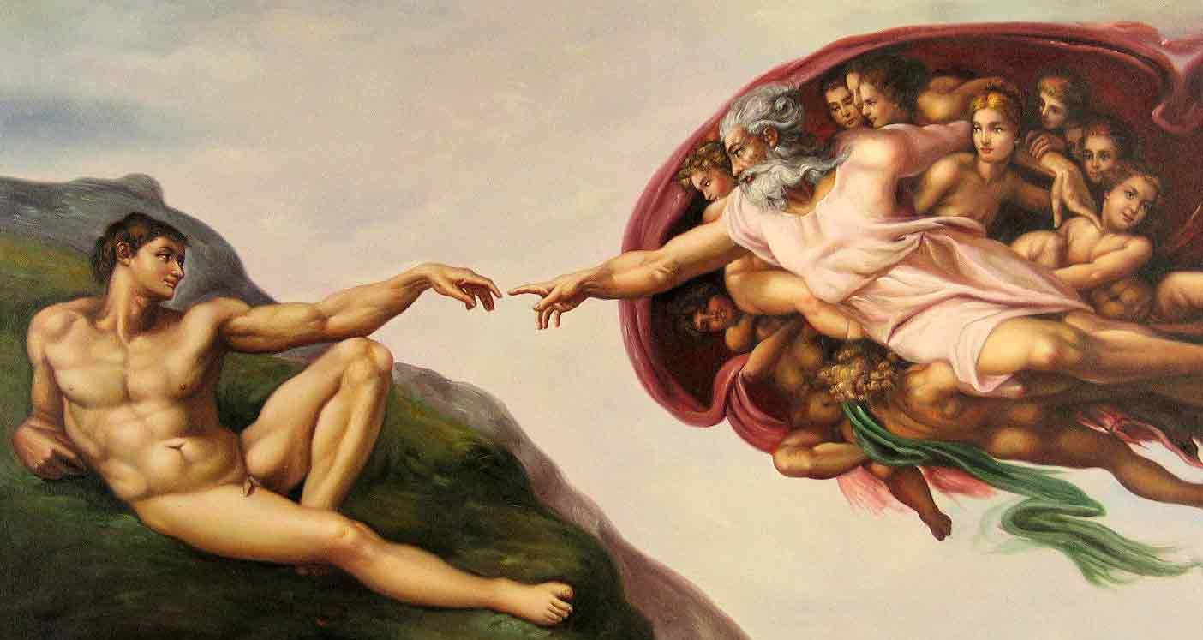
1) Work is man’s essential vocation.
“The LORD God took the man and put him in the Garden of Eden to work it and take care of it”
(Gen 2:15).

Slide 49
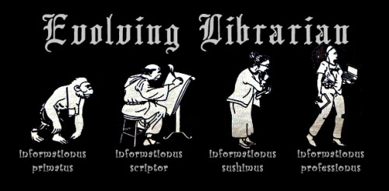
The Meaning of Work
a) For a Christian, work is a participation in God's work of creation.

Slide 50
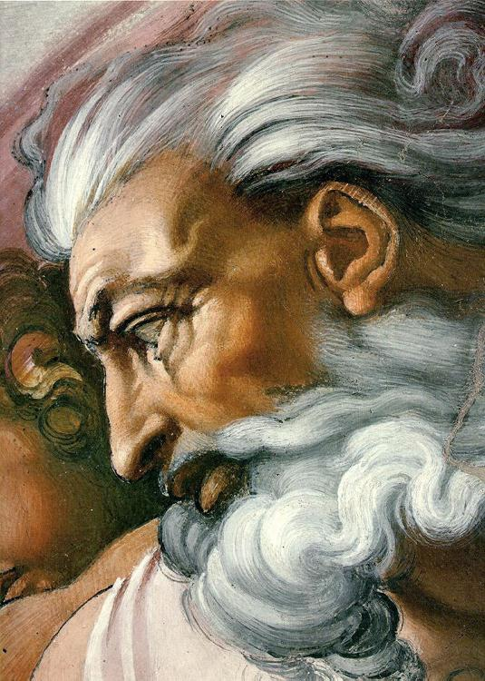
God created man ut operaretur (in order to work) so that by working he would, in a certain way, prolong the work of creation and attain his own perfection.
TWO REASONS WHY DO WE WORK

Slide 51
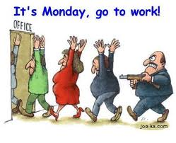
The Meaning of Work
b) As a consequence of sin, work is often accompanied by fatigue and suffering.

Slide 53
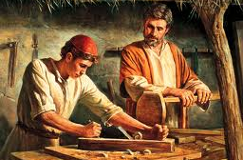
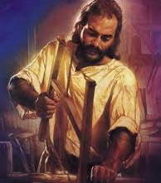
The Meaning of Work
c) Christ our Lord has transformed this fatigue and suffering into means for showing love for and obedience to God’s will and making up for the disobedience of sin.

Slide 54
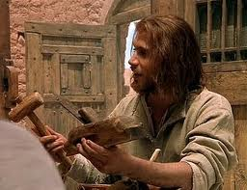
As Christians, our deep union with Christ through Baptism sheds light on the meaning of all our activities, and especially our work.

Slide 55
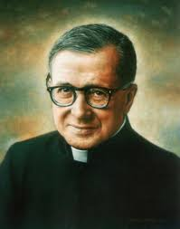
“Christ wishes to become incarnate in our tasks”
-- St. Josemaria Escriva,
Christ is passing by, 174
St. Josemaria Escriva
Patron Saint of Ordinary Life

Slide 56
2. Man can sanctify his work.
and let down the nets for a catch
-Lk.5:4

Slide 57
HOW DO I SANCTIFY MY WORK?
A) Work in the presence of God. Be aware that God is always watching you.

Slide 58
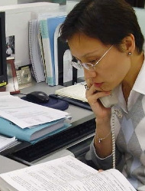
In order to sanctify one’s work, it is essential to seek the presence of God.

Slide 59
HOW DO I SANCTIFY MY WORK?
B) Work with rectitude of intention. Your work must be done for the greater glory of God.

Slide 60
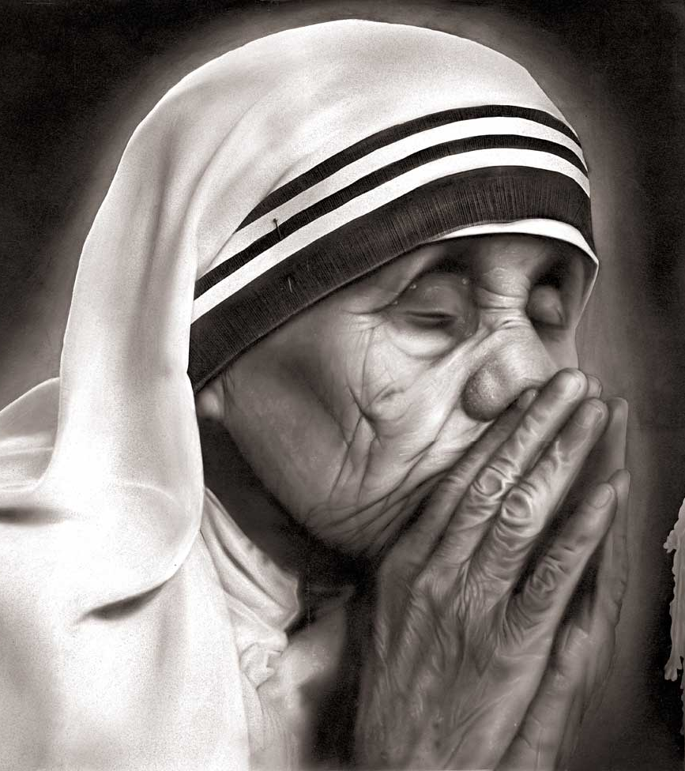
What really matters, therefore, is not that it "turn out well" but that we work out of love for God. For God looks to the heart.

Slide 61
What is decisive is that one has a supernatural motive, the ultimate goal, the rectitude of intention to work for love of God and to serve others for God.

Slide 62
"Add a supernatural motive to your ordinary work, and you will have sanctified it.“
(St. Josemaria, The Way, 359).
St. Josemaria Escriva
Patron Saint of Ordinary Life

Slide 63
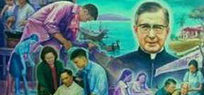
"Work is thus raised to the order of grace. It is sanctified and becomes God’s work, operatio Dei, opus Dei”.
(St. Josemaria, Conversations, 10).

Slide 64
HOW DO I SANCTIFY MY WORK?
C) Work with professionalism: Do your best. Mediocrity is the enemy of sanctity.

Slide 65
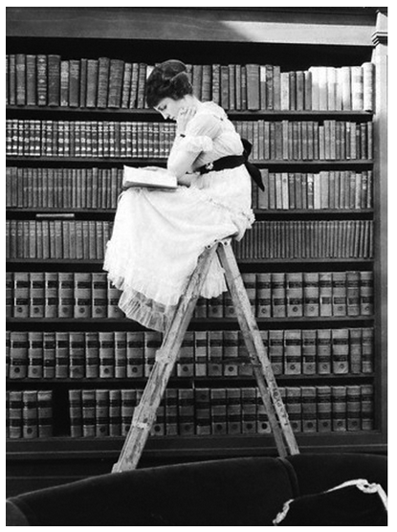
In the case of professional work, whether cultivating a field, research in science, providing services, etc., in order for it to be humanly good and sanctifiable it has to be an exercise of the human virtues.

Slide 66
PROFESSIONAL ETHICS
Principles that guide the librarian’s profession.

Slide 67
To ensure access to information for all for personal development, education, cultural enrichment, leisure, economic activity and informed participation in and enhancement of democracy.
Access to information

Slide 68
To ensure that equitable services are provided for everyone regardless of age, citizenship, political belief, physical or mental ability, gender identity, heritage, education, income, immigration and asylum-seeking status, marital status, origin, race, religion or sexual orientation
Responsibilities towards individuals and society

Slide 69
To respect personal privacy, and the protection of personal data, necessarily shared between individuals and institutions.
Privacy, secrecy and transparency

Slide 70
To provide the best possible access for library users to information and ideas in any media or format.
Open access and intellectual property

Slide 71
To distinguish between their personal convictions and professional duties. They do not advance private interests or personal beliefs at the expense of neutrality.
To counter corruption directly affecting librarianship, as in the sourcing and supply of library materials…
Neutrality, personal integrity and professional skills

Slide 72
To share their professional experience with colleagues and they help and guide new professionals to enter the professional community and develop their skills.
To strive to earn a reputation and status based on their professionalism and ethical behavior. They do not compete with colleagues by the use of unfair methods.
Colleague and employer/employee relationship

Slide 73
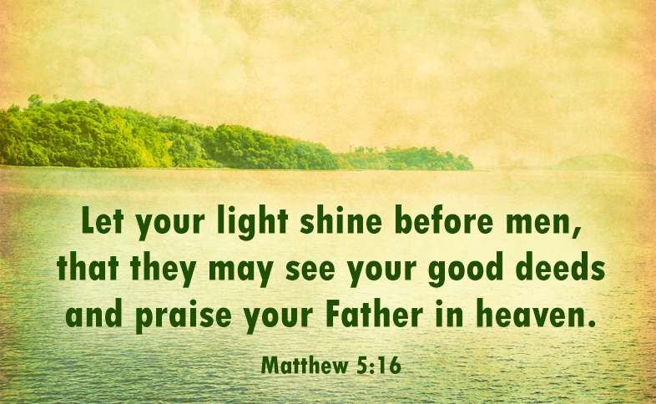
3. Man can sanctify himself and others through his work.

Slide 74
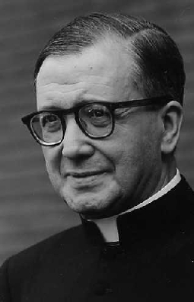
“Professional work, whatever it is, becomes a lamp to enlighten your colleagues and friends…
‘What use is it telling me that so and so is a good Christian, but a bad shoemaker?’
LIBRARIAN
“If he doesn’t try to learn his trade well, or doesn’t give his full attention to it, he won’t be able to sanctify it or offer it to Our Lord.”
(St. Josemaria Escriva, Friends of God, 61)

Slide 75
“The sanctification of ordinary work is
the hinge of true spirituality for people who, like us, have decided to come close to God while being at the same time fully involved in temporal affairs.”
(St. Josemaria Escriva, Friends of God, 61)

Slide 76
Are you still awake?
Chickens in Libraries?

Slide 77
Conclusion
UNIVERSAL CALL TO HOLINESS
We are all here because we want to become better librarians.
But we can aim more than that: we want to become HOLY LIBRARIANS – librarians striving to be holy.

Slide 78
Conclusion
BATTLES IN MORAL LIFE
Holiness is difficult but possible because God grants us the necessary grace and we struggle to respond to that grace by striving to LIVE A MORAL LIFE – a life of virtues.

Slide 79
Conclusion
PERSONAL SANCTIFICATION THROUGH ONE’S PROFESSION
Our profession and our daily tasks can be our means of sanctification because it is where the LORD expects us to live a life of piety and human virtues.

Slide 80
“Heaven and earth seem to merge, my sons and daughters, on the horizon. But where they really meet is in your hearts, when you sanctify your everyday lives”.
(St.. Josemaria Escriva)

Slide 81
For your attention

